Slide 1

Web Development Day – 01 By J. Siv Ram Shastri

Slide 2
How Web Works?
HTML: HyperText Markup Language. The markup (formatting) language for the web.
URI: Uniform Resource Identifier. A kind of “address” that is unique and used to identify to each resource on the web. It is also commonly called a URL.
HTTP: Hypertext Transfer Protocol. Allows for the retrieval of linked resources from across the web.

Slide 3
Intro to HTML
HTML is the standard markup language for Web pages.
With HTML you can create your own Website.
HTML stands for Hyper Text Markup Language
HTML is the standard markup language for creating Web pages
HTML describes the structure of a Web page
HTML consists of a series of elements
HTML elements tell the browser how to display the content
HTML elements label pieces of content such as "this is a heading", "this is a paragraph", "this is a link", etc.

Slide 4
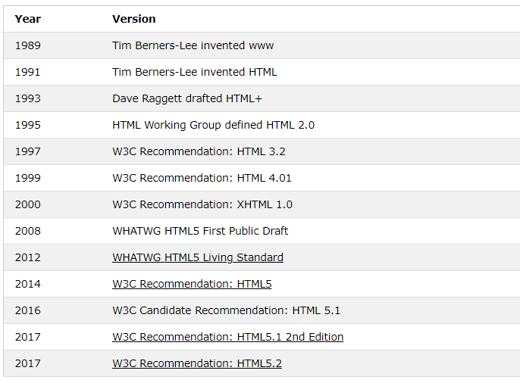
History of HTML

Slide 5
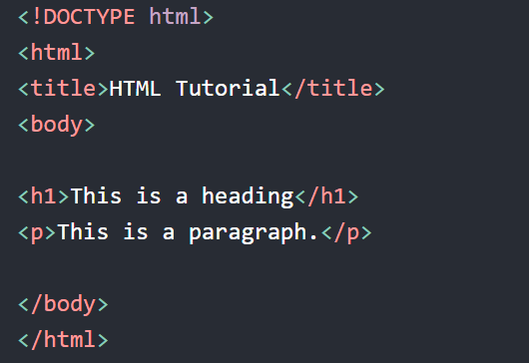
Basic HTML example

Slide 6
Mandatory Tags used in HTML
The <!DOCTYPE html> declaration defines that this document is an HTML5 document
The <html> element is the root element of an HTML page
The <head> element contains meta information about the HTML page
The <title> element specifies a title for the HTML page (which is shown in the browser's title bar or in the page's tab)
The <body> element defines the document's body, and is a container for all the visible contents, such as headings, paragraphs, images, hyperlinks, tables, lists, etc.
The <h1> element defines a large heading
The <p> element defines a paragraph

Slide 7
What is an HTML Element?
An HTML element is defined by a start tag, some content, and an end tag:
<tagname>Content goes here...</tagname>
The HTML element is everything from the start tag to the end tag:
<h1>My First Heading</h1>
<p>My first paragraph.</p>

Slide 8
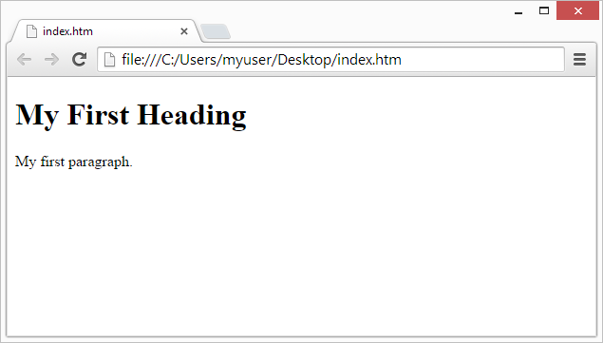
Web Browsers
The purpose of a web browser (Chrome, Edge, Firefox, Safari) is to read HTML documents and display them correctly.
A browser does not display the HTML tags, but uses them to determine how to display the document

Slide 9
HTML Headings
HTML headings are defined with the <h1> to <h6> tags.
<h1> defines the most important heading. <h6> defines the least important heading
Example
<h1>This is heading 1</h1>
<h2>This is heading 2</h2>
<h3>This is heading 3</h3>

Slide 10
HTML Paragraphs & Links
HTML paragraphs are defined with the <p> tag:
Example
<p>This is a paragraph.</p>
<p>This is another paragraph.</p>
HTML Links
HTML links are defined with the <a> tag:
Example
<a href="https://www.w3schools.com">This is a link</a>

Slide 11
HTML Images
HTML images are defined with the <img> tag.
The source file (src), alternative text (alt), width, and height are provided as attributes
Example
<img src="w3schools.jpg" alt="W3Schools.com" width="104" height="142">

Slide 12
HTML Attributes
All HTML elements can have attributes
Attributes provide additional information about elements
Attributes are always specified in the start tag
Attributes usually come in name/value pairs like: name="value"
The href Attribute:
The <a> tag defines a hyperlink. The href attribute specifies the URL of the page the link goes to:
Example
<a href="https://www.w3schools.com">Visit W3Schools</a>

Slide 13
The src & alt Attributes
The <img> tag is used to embed an image in an HTML page. The src attribute specifies the path to the image to be displayed:
Example
<img src="img_girl.jpg">
The alt Attribute
The required alt attribute for the <img> tag specifies an alternate text for an image, if the image for some reason cannot be displayed. This can be due to slow connection, or an error in the src attribute, or if the user uses a screen reader.
Example
<img src="img_girl.jpg" alt="Girl with a jacket">

Slide 14
HTML Lists
HTML lists allow web authors to group a set of related items in lists.
Example
An unordered HTML list:
Item
Item
An ordered HTML list:
first item
Second item
Third item
Fourth item

